Slide 1
Tutorial 3
Convex Sets and Functions

Slide 2
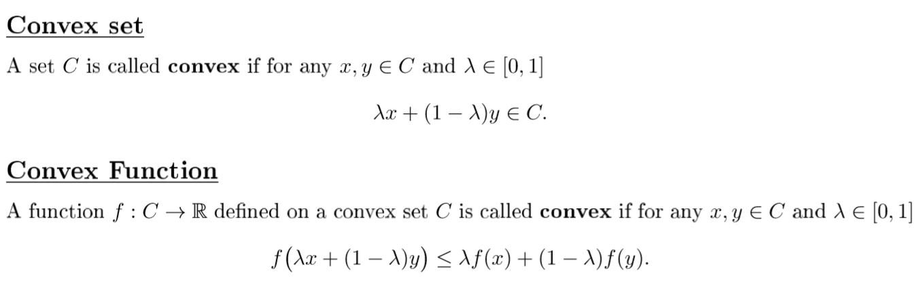

Slide 3
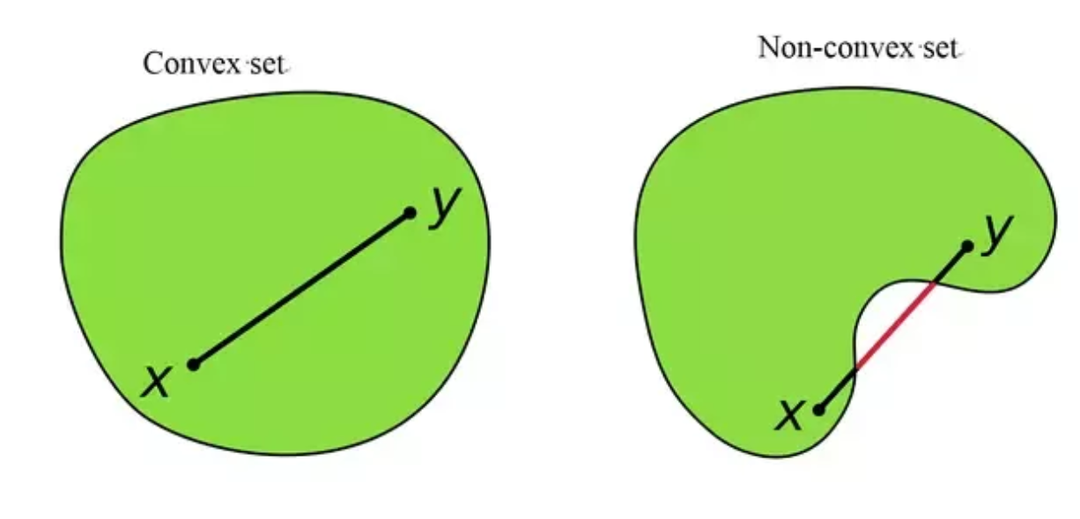
Convex and Non-convex set

Slide 4
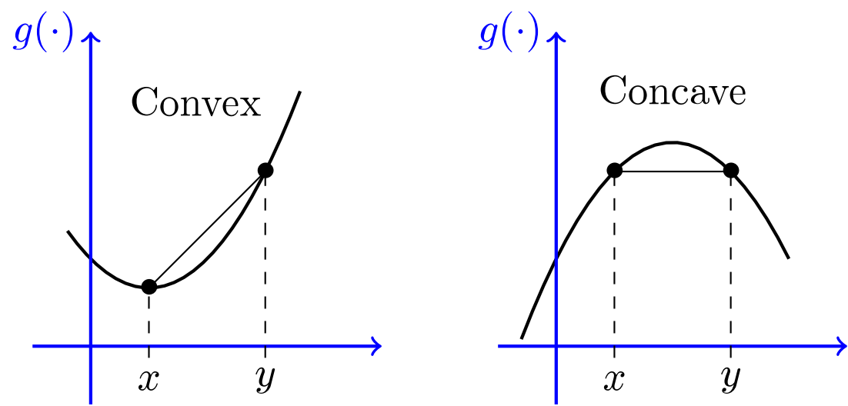
Convex and concave functions

Slide 5
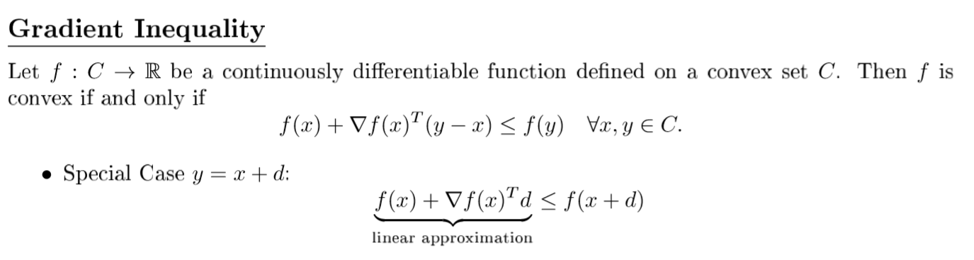
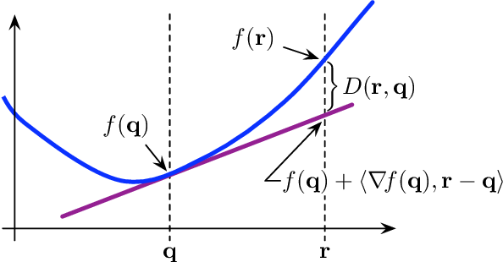

Slide 6
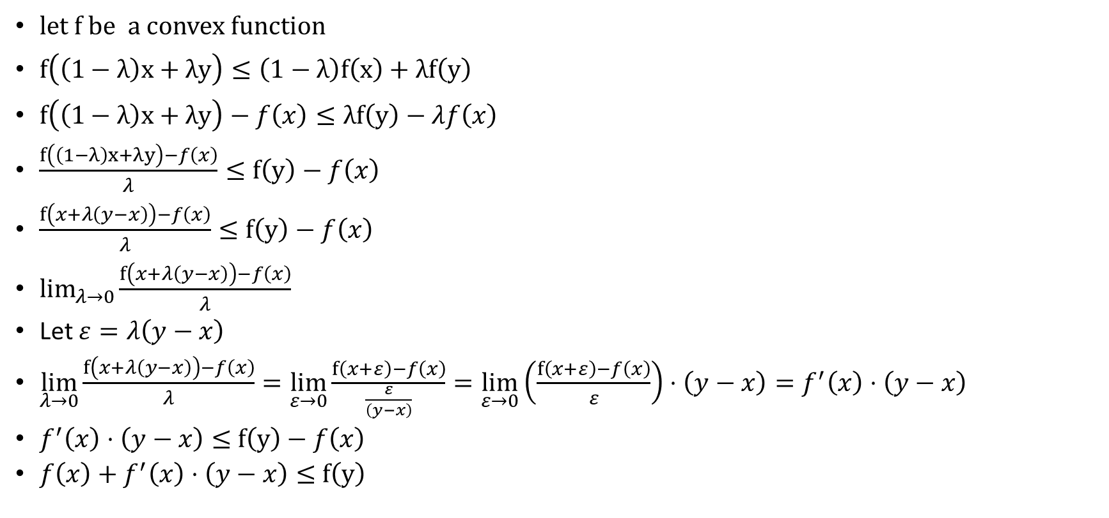
Proof of the gradient Inequality
$let f$ be a convex function
$f\left(\left(1−λ\right)x+λy\right)≤\left(1−λ\right)f\left(x\right)+λf\left(y\right)$
$f\left(\left(1−λ\right)x+λy\right)−f\left(x\right)≤λf\left(y\right)−λf\left(x\right)$
$\frac{f\left(\left(1−λ\right)x+λy\right)−f\left(x\right)}{λ}≤f\left(y\right)−f\left(x\right)$
$\frac{f\left(x+λ\left(y−x\right)\right)−f\left(x\right)}{λ}≤f\left(y\right)−f\left(x\right)$
$\lim_{λ→0}{\frac{f\left(x+λ\left(y−x\right)\right)−f\left(x\right)}{λ}}$
Let $ε=λ\left(y−x\right)$
$\lim_{λ→0}{\frac{f\left(x+λ\left(y−x\right)\right)−f\left(x\right)}{λ}}=\lim_{ε→0}{\frac{f\left(x+ε\right)−f\left(x\right)}{\frac{ε}{\left(y−x\right)}}}=\lim_{ε→0}\left(\frac{f\left(x+ε\right)−f\left(x\right)}{ε}\right)⋅\left(y−x\right)=f^{′}\left(x\right)⋅\left(y−x\right)$
$f^{′}\left(x\right)⋅\left(y−x\right)≤$ $f\left(y\right)−f\left(x\right)$
$f\left(x\right)+f^{′}\left(x\right)⋅\left(y−x\right)≤$ $f\left(y\right)$

Slide 7
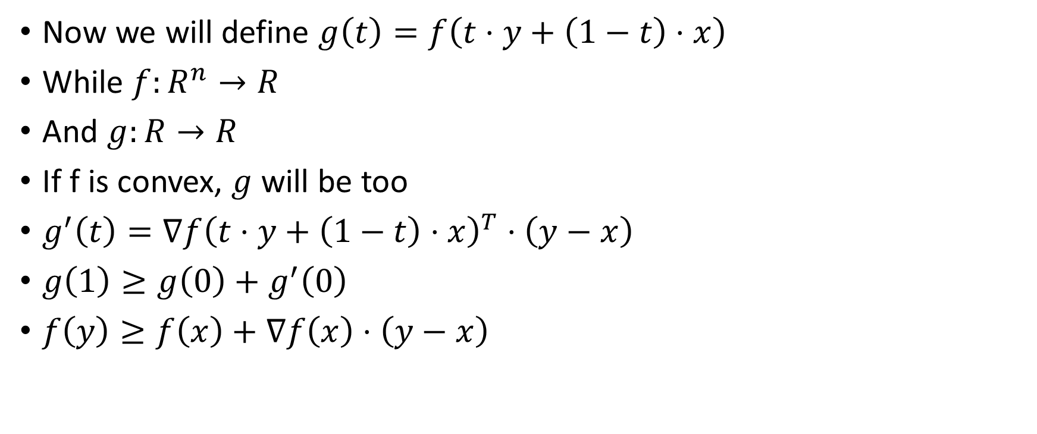
Proof of the gradient Inequality
Now we will define $g\left(t\right)=f\left(t⋅y+\left(1−t\right)⋅x\right)$
While $f:R^{n}→R$
And $g:R→R$
If f is convex, $g$ will be too
$g^{′}\left(t\right)=∇f{\left(t⋅y+\left(1−t\right)⋅x\right)}^{T}⋅\left(y−x\right)$
$g\left(1\right)≥g\left(0\right)+g^{′}\left(0\right)$
$f\left(y\right)≥f\left(x\right)+∇f\left(x\right)⋅\left(y−x\right)$

Slide 8
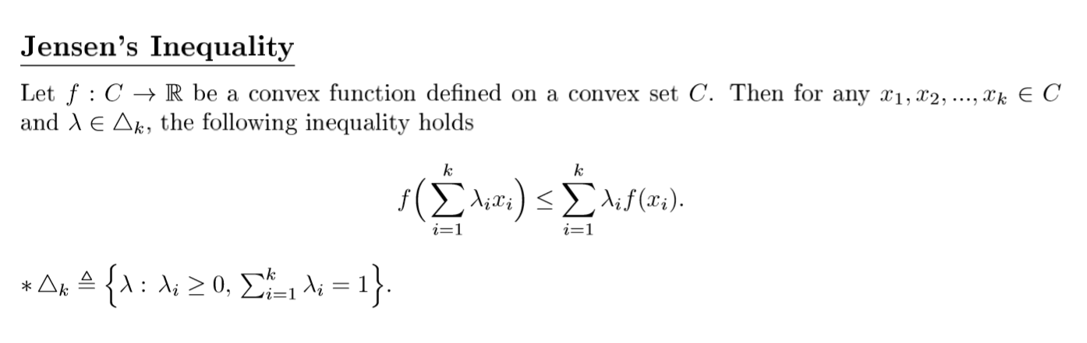

Slide 9
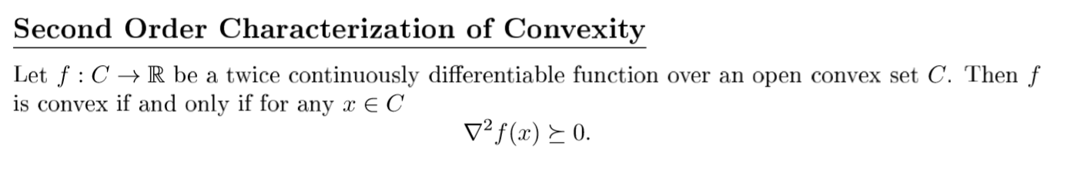

Slide 10
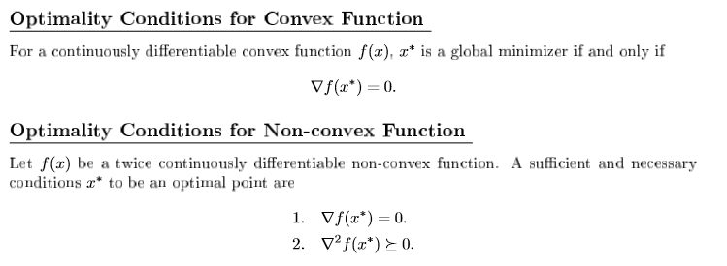

Slide 12
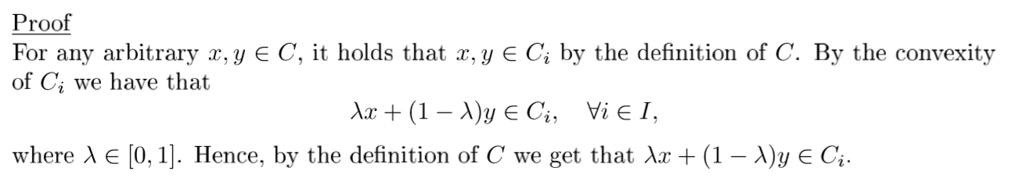

Slide 13
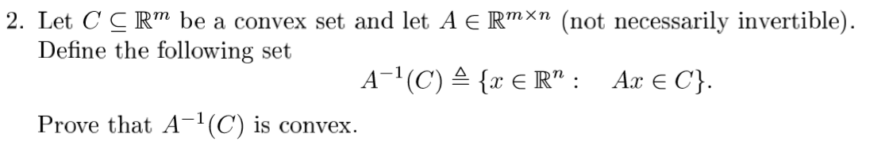

Slide 14
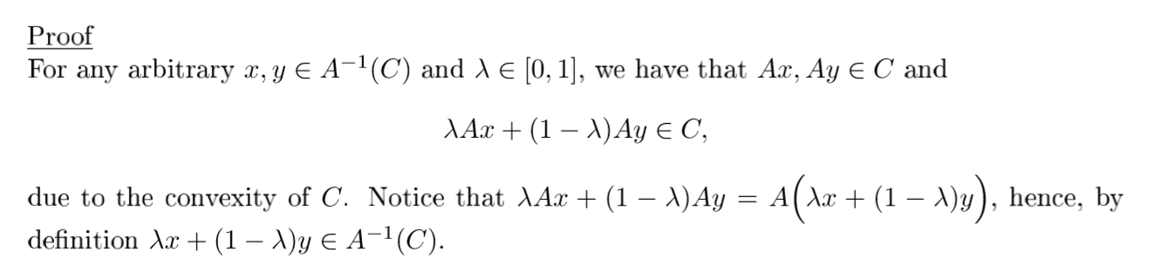

Slide 15
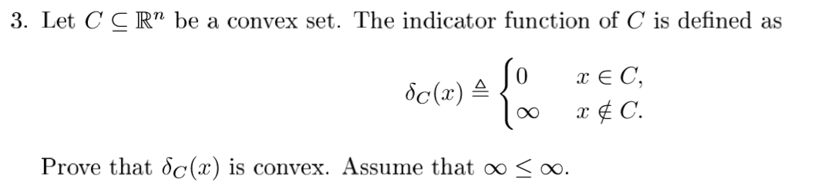

Slide 16
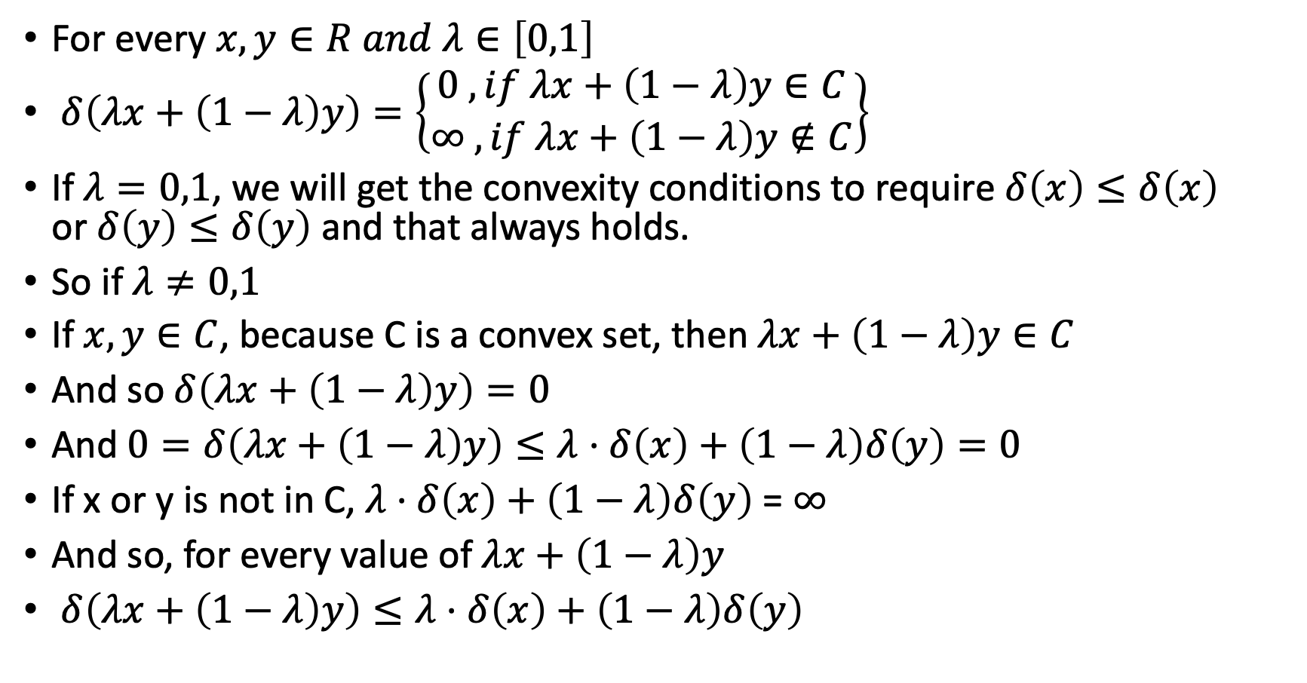
For every $x,y∈R and λ∈\left[0,1\right]$
$δ\left(λx+\left(1−λ\right)y\right)=\left\{\begin{aligned}0 , if λx+\left(1−λ\right)y∈C \\ ∞ ,if λx+\left(1−λ\right)y∉C\end{aligned}\right\}$
If $λ=0,1$, we will get the convexity conditions to require $δ\left(x\right)≤δ\left(x\right)$ or$δ\left(y\right)≤δ\left(y\right)$ and that always holds.
So if $λ≠0,1$
If $x,y∈C$, because C is a convex set, then $λx+\left(1−λ\right)y∈C$
And so $δ\left(λx+\left(1−λ\right)y\right)=0$
And $0=δ\left(λx+\left(1−λ\right)y\right)≤λ⋅δ\left(x\right)+\left(1−λ\right)δ\left(y\right)=0$
If x or y is not in C, $λ⋅δ\left(x\right)+\left(1−λ\right)δ\left(y\right)$ = $∞$
And so, for every value of $λx+\left(1−λ\right)y$
$δ\left(λx+\left(1−λ\right)y\right)≤λ⋅δ\left(x\right)+\left(1−λ\right)δ\left(y\right)$

Slide 17
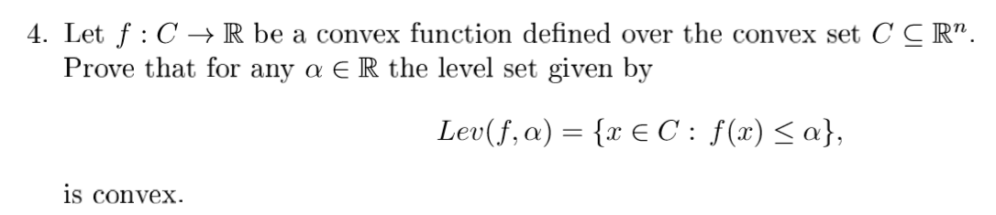

Slide 18
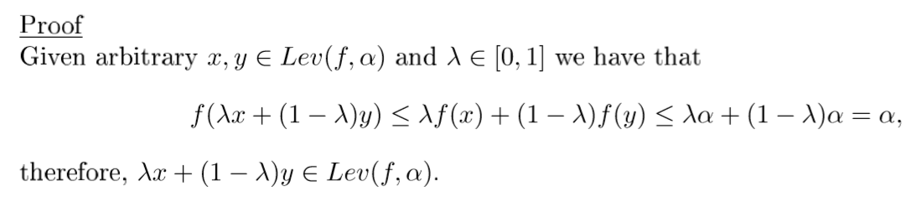

Slide 19
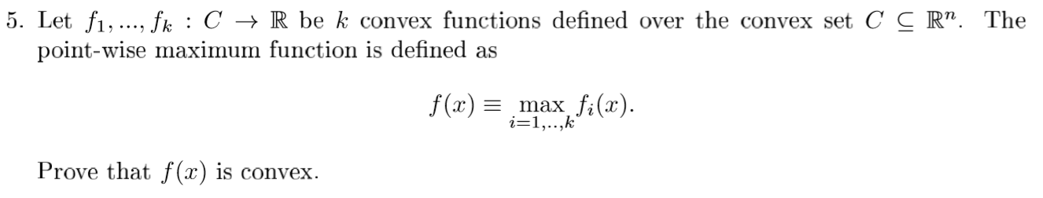

Slide 20
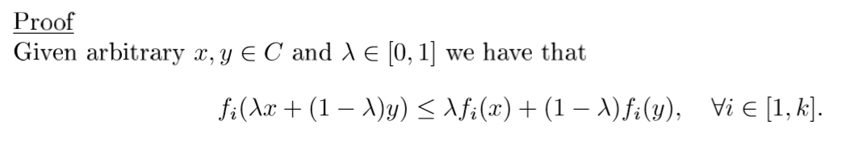
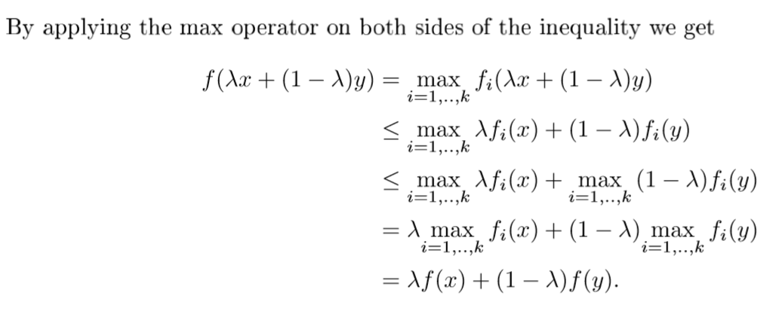

Slide 21
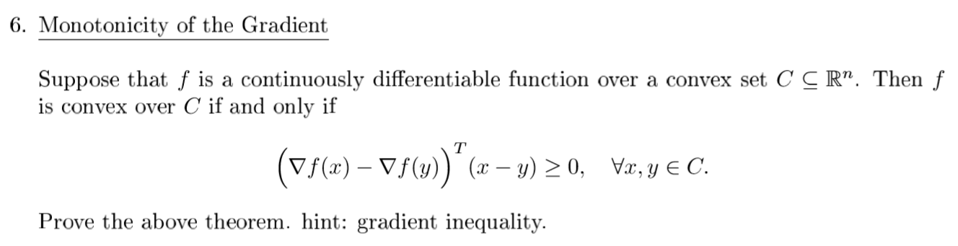

Slide 22
